Slide 1
DEEP LEARNING

Slide 2
ARTIFICIAL INTELLLIGENCE
MACHINE LEARNING
Artificial intelligence is the process of creating smart human-like machines. AI-powered machines aim to think and act like humans. Machines gather human intelligence by processing and converting the data in their system. Most machines with artificial intelligence aim to solve complex problems like healthcare innovation, safe driving, clean energy, and wildlife conservation.
Machine learning utilizes statistical algorithms to create predictive models based on past learnings and findings. Machine learning applications process a lot of data and learn from the rights and wrongs to build a strong database.
A common example of machine learning is a chatbot used for assisting existing and potential customers online

Slide 3
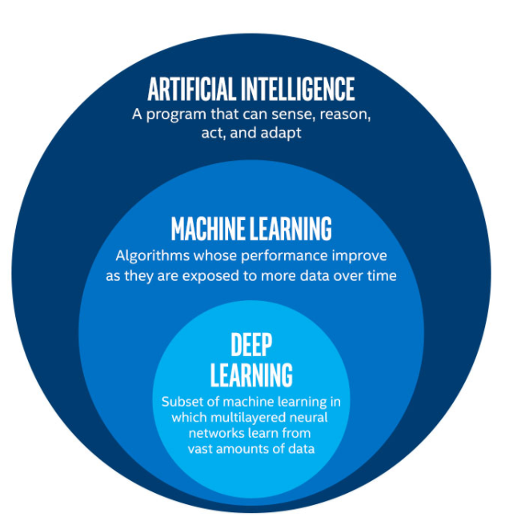
WHAT IS DEEPLEARNING?
Teaching computers to recognise patterns in data
It can be used for fake news detection ,autonomous vehicles ,etc.
Google’s DeepMind developed a deeplearning computer program that defeated world champion of GO, that is many times complex than chess
Deep learning is part of a broader family of machine learning methods based on artificial neural networks with representation learning

Slide 4
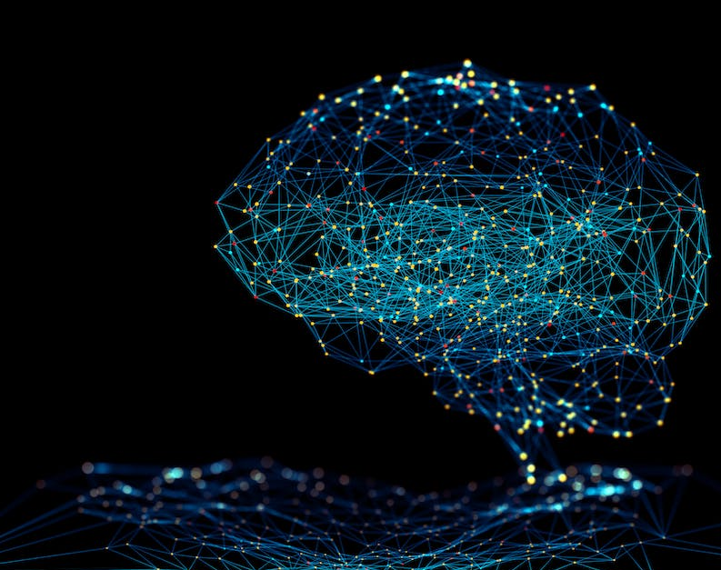
WHAT IS NEURAL NETWORKS
Neural networks, also known as artificial neural networks (ANNs) or simulated neural networks (SNNs), are a subset of machine learning and are at the heart of deep learning algorithms
Their name and structure are inspired by the human brain, mimicking the way that biological neurons signal to one another.

Slide 5
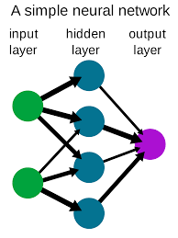
A neural network is a series of algorithms that endeavors to recognize underlying relationships in a set of data through a process that mimics the way the human brain operates. In this sense, neural networks refer to systems of neurons, either organic or artificial in nature.
Basically , Neuron is a thing that holds a number.
This number inside the neuron is called its activation.

Slide 6
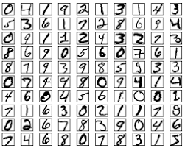
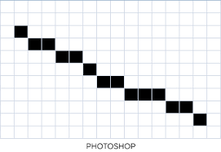

Slide 7
WHY ARE NEURAL NETWORKS NEEDED?
Machine learning and other types of learning came to solve a very important need : Can a device learn on its own to solve a particular task.
It was needed because many problems couldn’t be programmed or very difficult or inefficient to program. Think about how you will make a program to identify a human. Understand that what you see is not what a computer sees. Instead of binary lets have an image be represented by an array. Now how will you make it identify a human when every human image is different in some way, it can be height, face structure, front, side and back portions of the same person. Do you see how complicated it is? That’s why we want to let the computer learn it on its own.

Slide 8
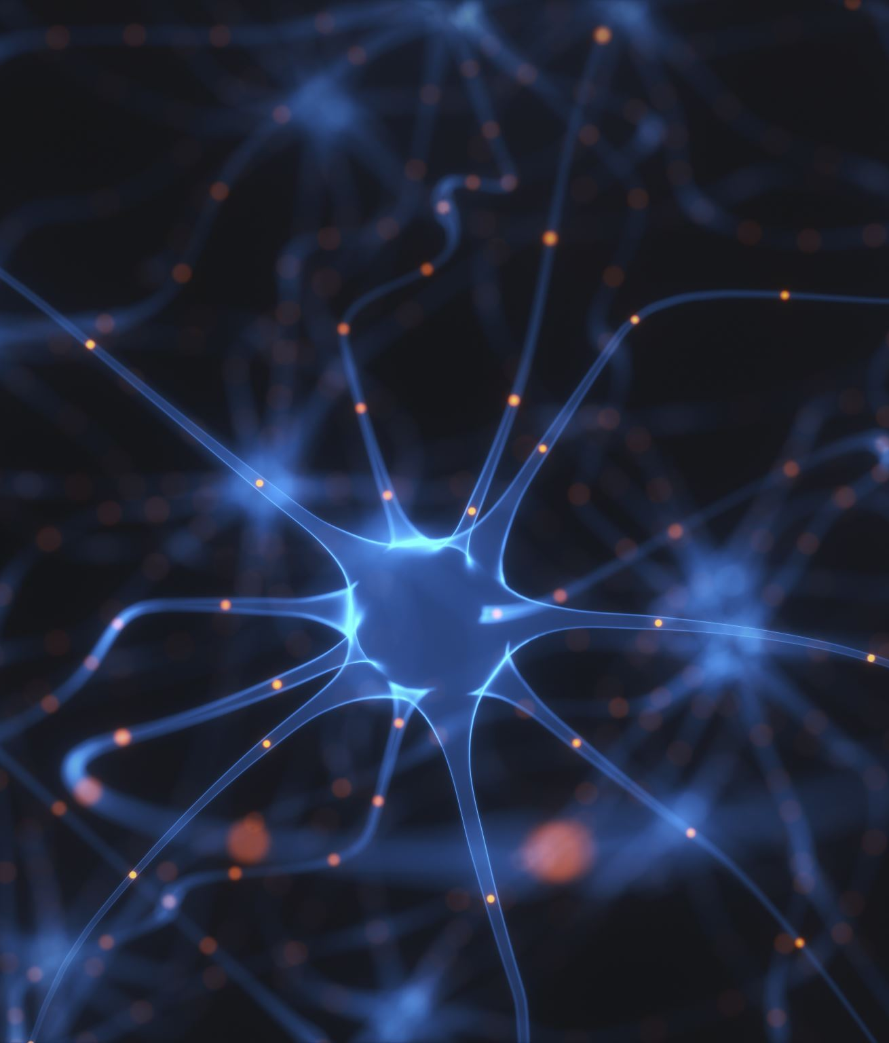
WHY ARE NEURAL NETWORKS NEEDED?
NN is a branch of ML which is inspired from brains which activate a neuron through chemical reactions to process information.
So neural network gets an input from the data, transforms and activates it. Then it gives the activated output to next layer be it output layer or another layer of NN.

Slide 9
LAYERS IN NEURAL NETWORKS
Neural Networks consists of three layers , They are
Input Layer
Hidden Layer
Output Layer
Input Layer:
The external information of a data is fed in the units of input layer
Output Layer:
This layer gives the output that predicts from the data fed into the input layer.
Hidden Layer:
The layers between the input and output layer are called hidden layers. These are intermediate layers. There can be many layers may be 1 or more than that.

Slide 10
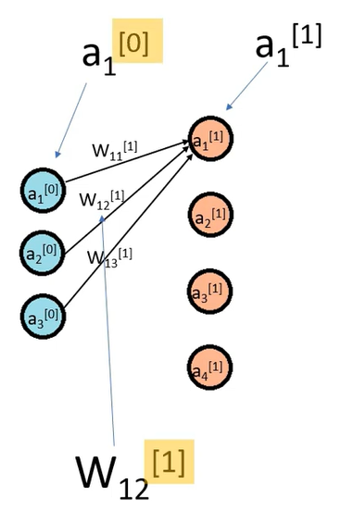
FORWARD PROPAGATION
It is the way to move from the Input layer (left) to the Output layer (right) in the neural network.
As we seen before
a1^{[1]} = activation _ function (W₁₁* a1^{[0]} + W₁₂* a2^{[0]} +
W₁₃* a3^{[0]} + b₁)
Here superscript represents the current layer and we are taking input layer as a zero layer.
Here subscript represents the position of a weight between two neurons.
Similarly a1^{[2]} = activation _ function (W₂₁* a1^{[1]} + W₂₂* a2^{[1]} + W₂₃* a3^{[1]} + b₂)

Slide 11
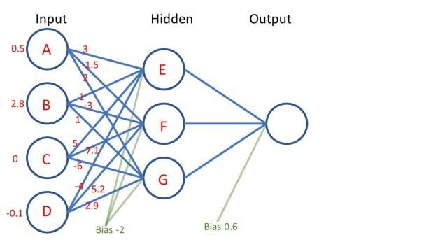

Slide 12
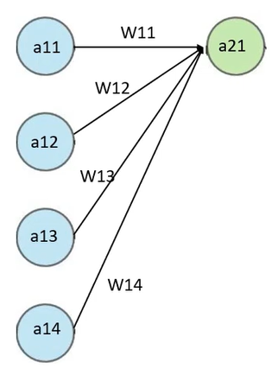
The connection between every pair of neurons is called Weights. It is the matrix with which we multiply the input.
This weights are the parameters that we train.
Weighted Sum :
Multiplication of every weight with every value of a neuron and addition of a bias.
Bias(b):
It determines the how high our weighted sum should be.
Weighted Sum = W11*a11+ W12*a12+ W13*a13+ W14*a14+ b

Slide 13
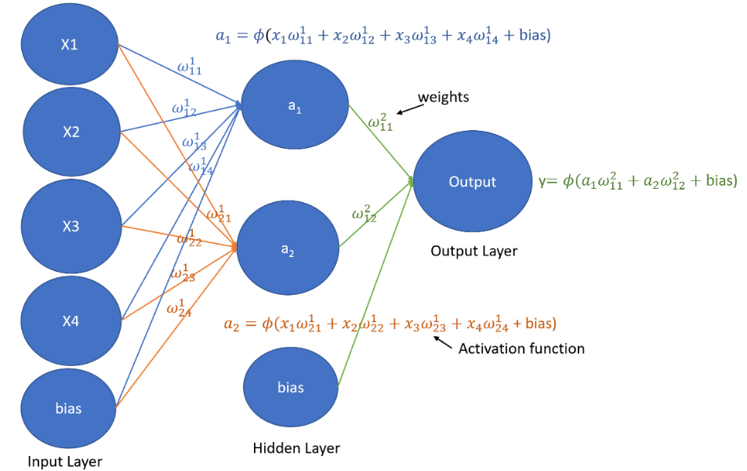
If bias b value is negative the weighted sum is less where else the value is high the weighted sum is high.
Bias is used to shift the resultant multiplication such that it gets activated or deactivated when its passed to an activation function.
a21 = activation _ function (W11*a11+ W12*a12+ W13*a13+ W14*a14+ b)

Slide 14
ACTIVATION FUNCTION IN NEURAL NETWORKS
Definition:
Activation function decides, whether a neuron should be activated or not by calculating weighted sum and further adding bias with it. The purpose of the activation function is to introduce non-linearity into the output of a neuron.
Why we need activation function?
Why we need activation function?
If suppose the weighted sum is not passed into the activation function,
Z1 = W1 * A0 + B1
A1 = f(Z1) A1 = z1 <= no activation function
Z2 = W2 * A1 + B2
A2 = f(Z2) a2=z2 <= no activation function

Slide 15
A2 = W2 * ( W1 * A0 + B1) + B2
A2 = W2 * W1 * A0 + W2 * B1 + B2
=> A2 = W’ * A0 + B’ ;
Similarly A3 = W’’ * A0 + B’’
No matters how many layers we use we get similar equations thus there is no advantage of multiple layers and it becomes one layer .
Without using the activation function all these become linear.
So we need to use a non linear activation function to take the benefit of different hidden layers and function must be non-linear.

Slide 16
TYPES OF ACTIVATION FUNCTIONS
Sigmoid function
Tanh Activation function
RelU Activation function
Softmax Activation Function

Slide 17
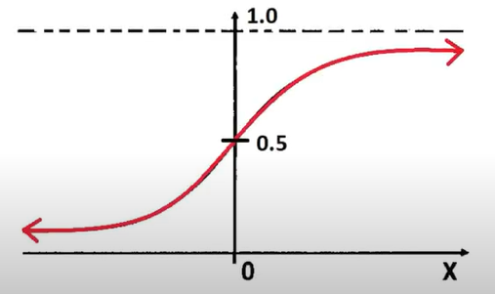
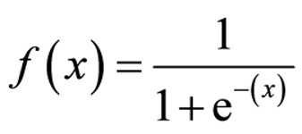
SIGMOID FUNCTION
It is a s shaped function and gives the value between ‘0’ and ‘1’ for given input value.
It is mostly used in output layer in the binary classification.
But it not used in hidden layers it has some drawbacks. We will see after the next activation.

Slide 18
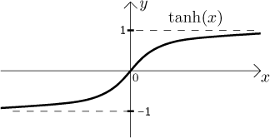
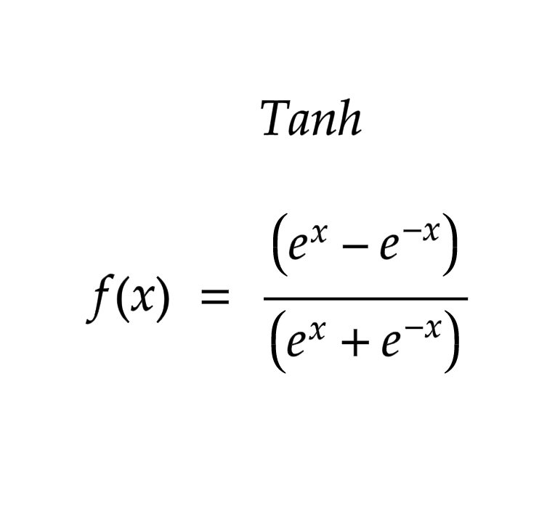
Tanh FUNCTION
It is similar to simoid function as it gives the value from ‘-1’ to ‘+1’
It has some advantages than sigmoid function when we use in hidden layers.
In backward propagation or in gradient descent we use derivatives of cost function with respective of W.
The cost function depends on activation function i.e the derivative of tanh

Slide 19
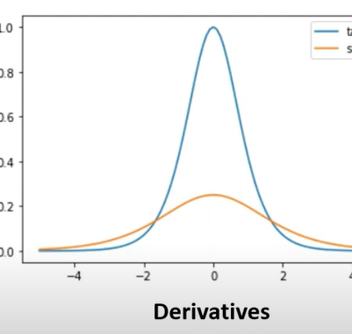
Basics of Derivatives
Here maximum value of derivative of sigmoid function is 0.25 whereas the derivative of tanh function is 1.
Thus using the tanh activation function we can train our model much faster as the derivative value is higher it will converge much faster and in tanh function the average of the data will be close to zero.
So when we use tanh function in hidden layers then it works much betters than sigmoid function.
It is because of the reason that the output of hidden layer which is also the input to next layer will have values as average close to zero and this makes training faster.

Slide 20
Basics of Derivatives
These two functions also has some disadvantages when we take the derivative of both functions in gradient descent we see for very high values of x and very low values of x the derivative becomes very small thus the training will become slow.
Now this is called vanishing gradient problem.
This can be resolved by another activation function i.e ReLU function.

Slide 21
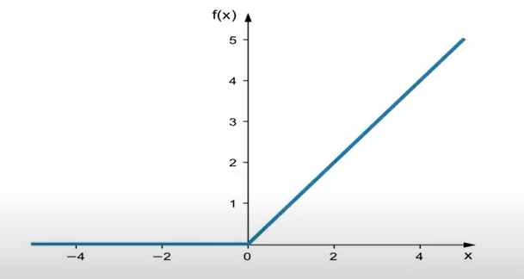
ReLU ACTIVATION FUNCTION
It is a linear function where we rectify the input which is less than zero.so the graph is look like this as shown.
f(x) =max(0,x)
It gives the value 0 for x<0 and same value x when x >0.
It overcomes the vanishing gradient descent problem.
The derivative of this function is 1 for x >0 and 0 for x < 0
Therefore the maximum derivative value is 1 same as tanh function so this also train the model faster

Slide 22
ReLU Function
The ReLU function has both linear and non-linear property
The linear property is useful for resolving the vanishing gradient descent problem and to train faster
Where the non-linear property takes the advantages or benefits of hidden layers

Slide 23
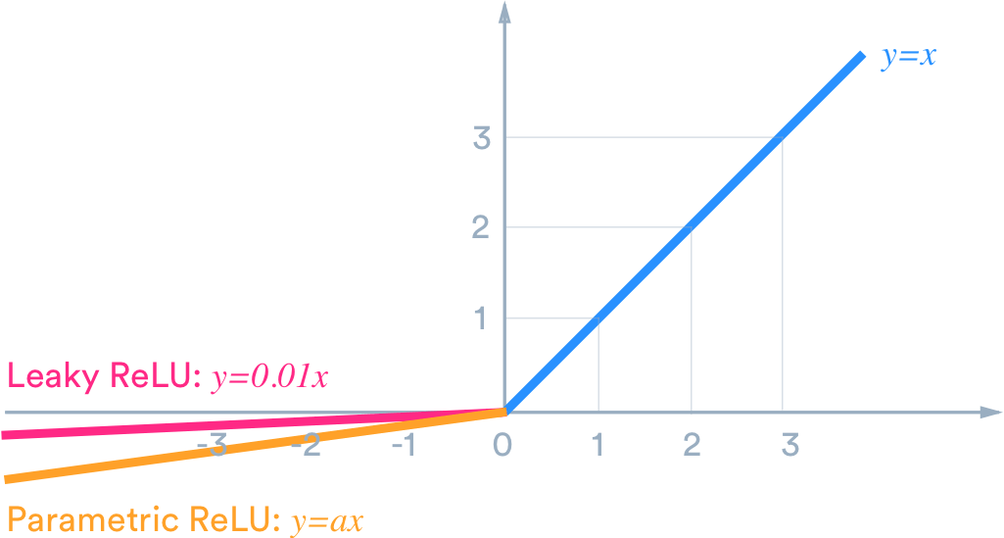

Slide 24
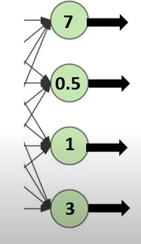
SOFT MAX FUNCTION
As we seen before for binary classification the sigmoid function is used for output layer , here for multi classification the sigmoid function is not useful.
Suppose we have neurons at output side has activation as shown
As we can see the output must be class1 i.e 7
But these output values can be made much better by scaling them into probabilities.
This can be achieved by taking exponential on the output values and dividing with sum of all exponentials of output values

Slide 25
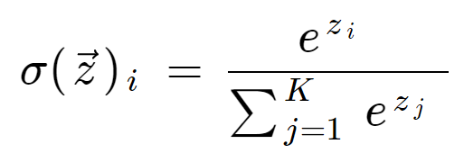
7 e^7 e^7/(e^7+e^0.5+e^1+e^3) 0.9782
0.5 e^0.5 e^0.5/(e^7+e^0.5+e^1+e^3) 0.00147
1 e^1 e^1/(e^7+e^0.5+e^1+e^3) 0.00242
3 e^3 e^3/(e^7+e^0.5+e^1+e^3) 0.0179
And the sum af all values is equal to ‘1’
Thus we converted all output values into probabilities and we will just classify the highest probability.

Slide 26
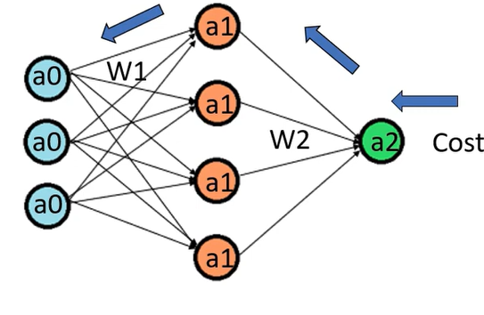
BACKWARD PROPAGATION
The process of moving from the right to left i.e backward from the Output to the Input layer is called the Backward Propagation.
Backward Propagation is the preferable method of adjusting or correcting the weights to reach the minimized loss function.

Slide 27
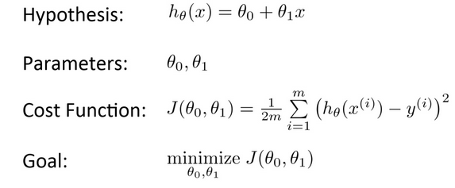
TERMS USED IN NN
Hyperparameters : Number of iterations the training model has run and learning rate are referred to as hyperparameters.
Cost function : The square of difference between expected output and output got from output layer
Parameters : Weights and biases are referred to as parameters.

Slide 28
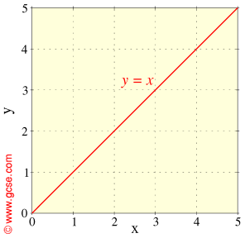
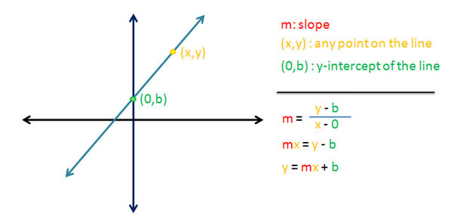

Slide 29
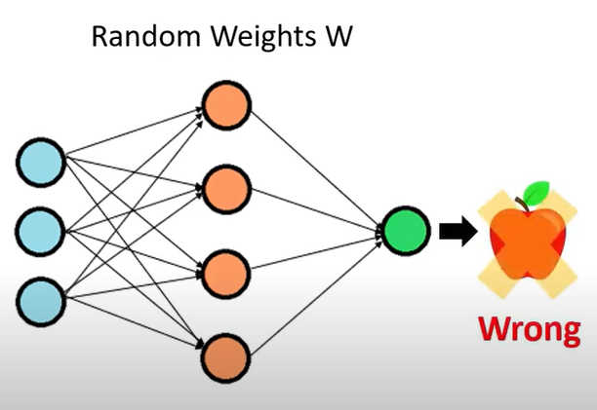
COST FUNCTION
Cost function in machine learning is ‘error representation’.
For example:
We initialize the weights randomly then our model are going to perform poor
So it give lot of wrong predictions.
Thus we can say the cost function is high.

Slide 30
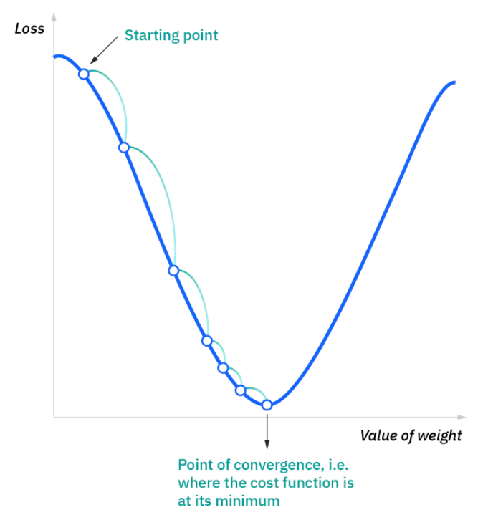
GRADIENT DESCENT
Gradient descent is an optimization algorithm which is commonly-used to train machine learning models and neural networks. Training data helps these models learn over time, and the cost function within gradient descent specifically acts as a barometer, gauging its accuracy with each iteration of parameter updates.

Slide 31
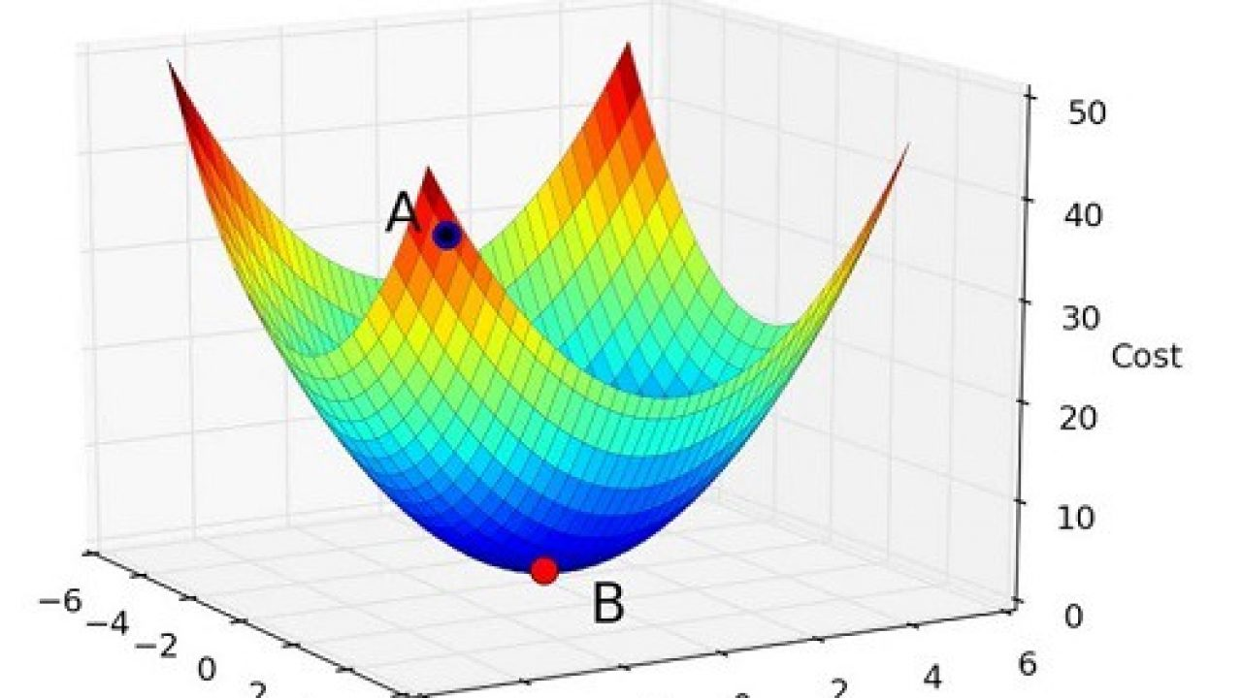
GRADIENT DESCENT

Slide 32
The starting point is just an arbitrary point for us to evaluate the performance. From that starting point, we will find the derivative (or slope), and from there, we can use a tangent line to observe the steepness of the slope. The slope will inform the updates to the parameters—i.e. the weights and bias. The slope at the starting point will be steeper, but as new parameters are generated, the steepness should gradually reduce until it reaches the lowest point on the curve, known as the point of convergence.
Similar to finding the line of best fit in linear regression, the goal of gradient descent is to minimize the cost function, or the error between predicted and actual y. In order to do this, it requires two data points—a direction and a learning rate. These factors determine the partial derivative calculations of future iterations, allowing it to gradually arrive at the local or global minimum (i.e. point of convergence). More detail on these components can be found below:

Slide 33
Repeat{
W= W₂ – alpha * ∂L / ∂W₂
B₂ = B₂ – alpha * ∂L / ∂ B₂
W₁ = W₁ – alpha * ∂L / ∂W₁
B₁ = B₁ – alpha * ∂L / ∂ B₁
}
This is the final gradient descent these all equations updates all weights in the model.
This equations are set as we taken before one hidden layer and one output layer.

